Slide 1


Fundamentals
Where do I find MATLAB? Here!
Do I have to have MATLAB installed on my computer right now? No, you can use MATLAB Online!

Slide 2

Table of Contents
What we've covered this week in Part 3 Variables and Commands Assigning Values to Variables Entering Commands The Command History Variables in the Base Workspace What we've covered this week in Part 4
MATLAB Live Script

Slide 3
What we've covered this week in Part 3
This week in Part 3 we learnt about:
Data types

Slide 4

Variables and Commands
Assigning Values to Variables
You can assign values to a variable using the equals sign (=), which is the assignment operator in MATLAB:
x = 6;
MATLAB computes the value of the expression on the right of the equals sign and then assigns that value to the variable named on the left.
If the variable on the left already exists, it is overwritten with the new value.
The expression to the right of the equals sign can be anything that MATLAB can evaluate:
x = 42;
y = x/6; % y has the value 7
x = 3.14; % y still has the value 7
y = y - 1; % y is now 6

Slide 5
Variables and Commands
When a computation is carried out but not explicitly assigned to a variable, MATLAB assigns the output to the default variable ans.
Run the code using the play button and see the output:
6*7
Entering just the name of a variable, with no assignment or calculation, returns the current value of that variable:
x
x =
3.1400

Slide 6
Variables and Commands
Run the code and see if the output matches the above:
x
Variables remain in memory until explicitly cleared:
clear x % deletes just x
clear % deletes all variables

Slide 7
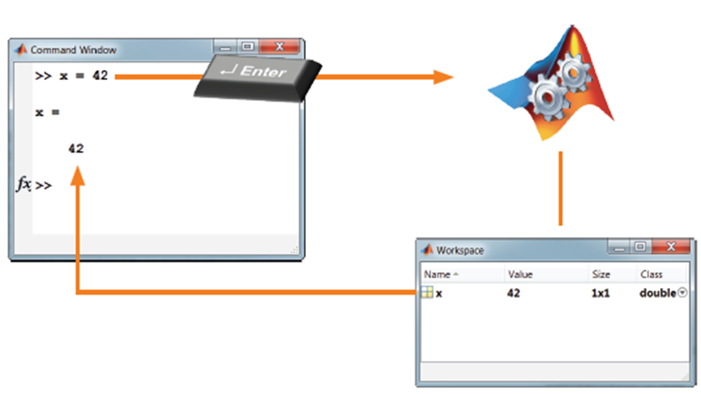
Entering Commands
Enter commands at the MATLAB prompt (> >) in the Command Window. MATLAB interprets and executes the command when you press the Enter key:
>> x = 42
x = 42
If the command generates text output, the output is shown in the Command Window.

Slide 8

Entering Commands
A semicolon (;) at the end of a command suppresses any output, although the command is still executed:
Enter the command below in the command window, do you see the output?
y = 3.14;
Note MATLAB is case sensitive: name is not the same as Name or NAME.
Enter the command below in the command window, do you see that there was an additional variable “Y” that was created?
Y = 3.14;
This Y variable is different from the y variable we defined previously.

Slide 9
Entering Commands
This Y variable is different from the y variable we defined previously.
Although the Command Window shows a record of the commands issued and the output returned, this record is not editable: only the current line can be edited.
Several keyboard shortcuts are available to assist in entering commands:
Home, End Move to the beginning, end of an expression
↑, ↓ Scroll through previous commands
Esc Deletes the expression at the prompt
Tab Displays commands that complete a partial expression
Useful commands for managing the Command Window are:
clc Clears the Command Window
home Moves the prompt to the top of the Command Window (without clearing commands)

Slide 10
The Command History
MATLAB automatically keeps a history of the commands you type. These commands remain from session to session until you choose to delete them.
Pressing the up-arrow key on your keyboard at the command prompt brings up the Command History window. In the Command History you can:
Scroll through commands with the up and down arrow keys.
Select commands with the mouse.
Select multiple commands (use Shift-click or Ctrl-click).
Edit recalled commands.
Re-enter commands.

Slide 11
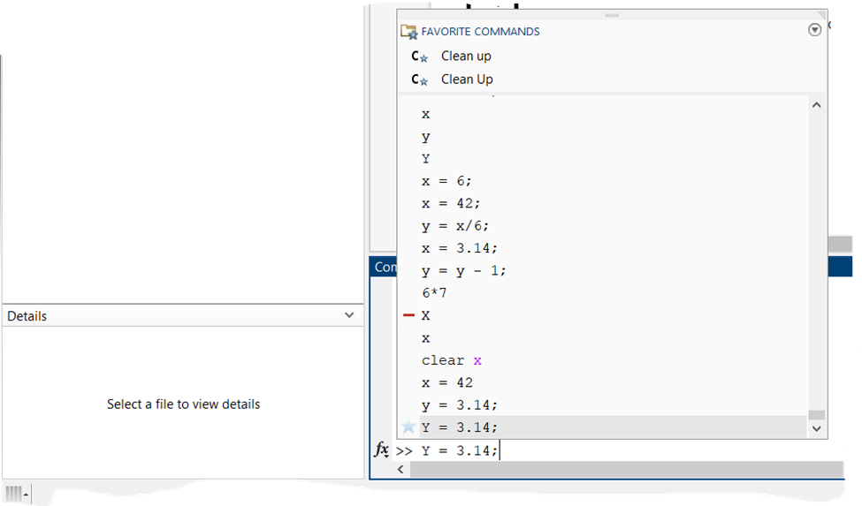
The Command History
If you partially enter a command, the Command History will be filtered to show only commands that match the portion entered. Use the window action menu to adjust the filtering options.
Later we’ll see how we can use the Command History to recall commands and help create scripts to automate your tasks.

Slide 12
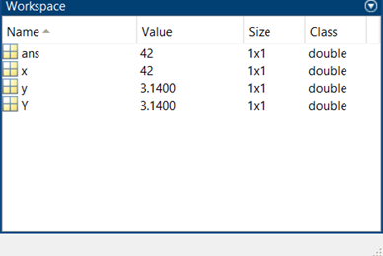
Variables in the Base Workspace
Commands executed in the command window or in a Live Script are stored in the form of MATLAB variables in the base workspace (MATLAB memory).
The contents of the base workspace are shown in the Workspace browser window. The browser displays the names of the variables currently in memory and (optionally) information about the variables (e.g., size and class).
You can rename a variable by right-clicking it in the Workspace browser and choosing Rename from the context menu.
Right-clicking on the Name button at the top of the Workspace browser displays a context menu from which you can choose which information to display about the variables.

Slide 13
What we've covered this week in Part 4
This week in Part 4 we learnt about:
Assigning values to variables
Entering commands
The command history
Variables in the base workspace

Slide 14
MATLAB Live Script
Click on the link below for this lecture’s MATLAB live Script
Week_1_Part_4_Fundamentals.mlx
Copyright 2022 The MathWorks, Inc. & Opti-Num Solutions (Pty) Ltd.

